Slide 1
Presentation on
THE PROJECT
DATA ANALYSIS OF CUSTOMER RETENTION IN ECOMMERCE SECTOR
Presented by Pratyush Raj
Fliprobo Sme- Md. Kashif

Slide 2
Introduction
Business Problem Framing
Customer satisfaction has emerged as one of the most important factors that guarantee the success of online store; it has been posited as a key stimulant of purchase or repurchase intentions and customer loyalty. A comprehensive review of the literature, theories and models have been carried out to propose the models for customer activation and customer retention. Five major factors that contributed to the success of an e- commerce store have been identified as: service quality, system quality, information quality, trust and net benefit.
Customer retention strategies enable you to both provide and extract more value from your existing customer base. You want to ensure the customers you worked so hard to acquire stay with you, have a great customer experience, and continue to get value from your products. Therefore, knowing how to maximize the repurchase intention of Indians online consumers’ is vital for an online retailer in India to achieve its business goals. This may further lead to develop a general reference model for successful online retail business. Success of an online retail website depends on its system quality and how much consumer motivator values are derived through shopping from it.
The research furthermore investigated the factors that influence the online customers repeat purchase intention. The combination of both utilitarian value and hedonistic values are needed to affect the repeat purchase intention (loyalty) positively. The data is collected from the Indian online shoppers. Results indicate the e-retail success factors, which are very much critical for customer satisfaction.

Slide 3
2. Conceptual Background of the Domain Problem
A successful business strategy today is not only developing cost- effective and highly targeted ways to reach out the new customers, it is more about keeping the existing customers engaged in the company. It has been acknowledged that bringing in new customers is expensive. Investment in the acquisition of new customers is six times higher than investing in existing customers. Increased performance in customer retention practices, on the other hand, has been found to create five times more impact than a similar amount of discount or cost of the capital, leading into the more profitable customer relationship.
Studies have suggested that past online shopping experience, perceived usefulness, and customer satisfaction are factors capable of influencing a customer’s repurchase intention.
Website quality (e-store) and the usability of the e-store have also been proposed as being very vital for e-retail success by studies.
The customer retention model illustrates that for a customer to become loyal to an online retail brand, there must be satisfaction, which arises when the e-tailer possesses a quality system backed- up by the proper mix of values.

Slide 4
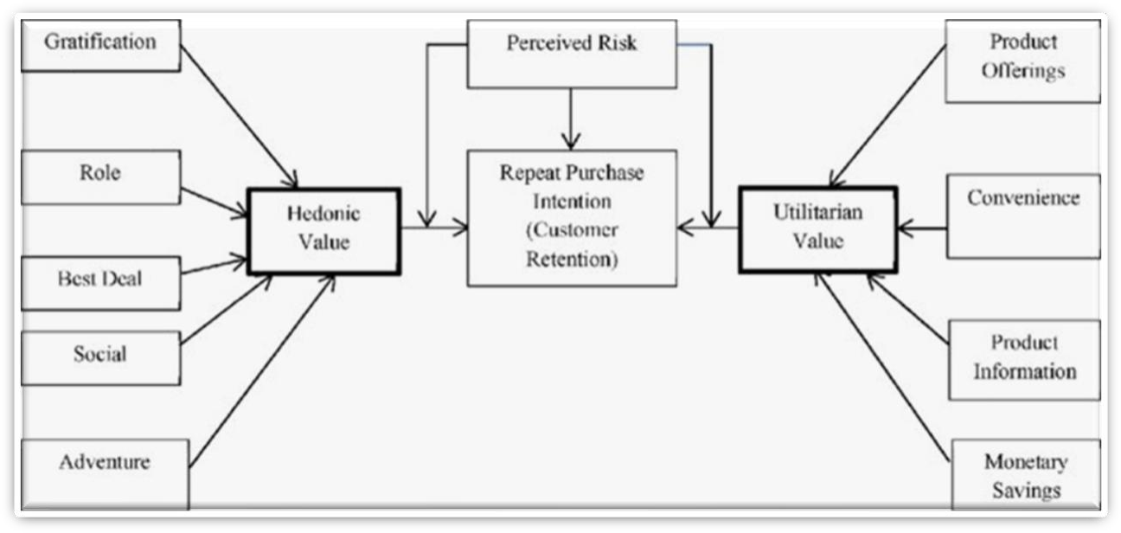

Slide 5
Analytical Problem Framing
Data Sources and their formats
The data is collected from the Indian online shoppers. Results indicate the e-retail success factors, which are very much critical for customer satisfaction. There are two sheets (one is detailed) and second is encoded in the excel file
Data Pre-processing
Before pre-processing data, integrity of data is check for missing values,
possible duplicates, to check if any whitespaces or (‘- ‘) is present or not.

Slide 6
Models Development & Evaluation
1.IDENTIFICATION OF POSSIBLE PROBLEM- SOLVING APPROACHES (METHODS)
There are lot of features in dataset. Our objective is to find key conclusions & finding related to data using analysis. The features are categorised into few sections so we can perform analysis data section wise focus on particular area. They are enlisted as below:
General feature describing Population and online shopping feature
Feature describing technological aspects related to internet services & device
Purchase Decision & Payment related features
Website Usability & performance related feature
shopping store customer service requirement related features
Feature related to Customer online shopping experiences
Online Shopping Platform related question response by Customer

Slide 7
VISUALIZATIONS
Through different graph we will try to find the different aspect of customer and how they are loyal
We will compare the customer and their way of shopping.
We will also see what medium they are using. How much time they are spending and who is leading the market and what is the reason behind it
For comparison we will make some barplot, pie chart and try to conclude out of it.
We will also see which brand is leading and which is lagging with what reason.

Slide 8
Based on analyse we have following recommendation for E-commerce companies.
.Amazon.com
Areas for further improvement:
During promotions, try to give a disturbance free shopping experience to customers.
Give more payment options to customers.
Try to give price early during promotion.
Reduce the delivery time of the products. Strong Area according to feedback by customer:
Convenient to use and also a good website for shopping.
Fast delivery of products.
Availability of complete information of the products.
Presence of online assistance through multi-channels.
Reliable website or app, perceived trustworthiness

Slide 9
Flipkart.com
Areas for further improvement:
During promotions, try to give a disturbance free shopping experience to customers.
Give more payment options to customers.
Try to give the price early during promotion.
Reduce the delivery time of the products.
Flipkart and Amazon almost share the same feedbacks with varying percentages as the only difference.
Strong Area according to feedback by customer:
Convenient to use and also a good website for shopping.
Fast delivery of products.
Availability of complete information of the products.
Presence of online assistance through multi-channels.
Reliable website or app, perceived trustworthiness.
Wild variety of products to offer.

Slide 10
Myntra.com
Areas for further improvement:
During promotions, try to give a disturbance free experience to customers.
Try to give the price early during promotions.
Reduce the delivery time of the products during promotions. Strong Area according to feedback by customer:
Convenient to use and also a good website.
Availability of several payment options.
Faster products delivery.
Complete information of products available.
Reliable website or app, perceived trustworthiness.
Wild variety of product to offer

Slide 11
Paytm.com
Areas for further improvement:
Reduce the delivery time of the products during promotions.
Try to give the price early during promotion.
During promotions, try to give a disturbance free shopping experience to customers.
Late declaration of price and discounts.
Frequent disturbance is occurring while moving from one page to another.
Strong Area according to feedback by customer:
Convenient to use and a good website.
Quickness to complete a purchase.
About 64% of the customers feel that either web or app is reliable.
Around 20% of the customers believe that Paytm has a wild variety of products on offer.

Slide 12
Conclusion: Key Findings and Conclusions of the Study
it is strong recommendation to companies that Do not spend more money over social media marketing & Display Adverts in their Digital Marketing campaign instead of that focus on Search engine Optimization & Email Marketing which will likely to be more effective to earlier.
Complete description product on website or app is essential from making purchase decision.
For both gender tendency of shopping is less for age greater than 51 years old.
Most of them agrees that the functioning of app efficiently is also a
major factor which helps in enhance user experience while doing online shopping.
Around 50% customers abandon cart due to better alternative offer
which is obvious reason. Another most common reason is promo code not applicable on particular product.
Paytm and Snapdeal has poor customer services and there is lot of scope for further improvement.
Amazon and Flipkart are standing best out in the market competent
business strategies and lot advantages over there competitor.
Mostly because, it is convenient and flexible, people prefer online shopping.
people who have been shopping for more then 3-4 years are the ones who frequently shops.
We can observe that most of the people, abandoned them cart as they were having better alternative offers
To conclude, having the right customer retention strategy will keep sellers company growing if they know how to take advantage of it.
Then customers will find their way back and continue buying stuff from the best company.

Slide 13
Snapdeal.com
Areas for further improvement:
Reduce the delivery time of the products during promotions.
Try to give the price early during promotion.
During promotions, try to give a disturbance free shopping experience to customers.
Late declaration of price and discounts.
No one has expressed to recommend Snapdeal to a contact as it has the most negative feedbacks among all other websites.
Strong Area according to feedback by customer:
Convenient to use.
54% of the customers are happy about the availability of financial information security.

